Slide 1
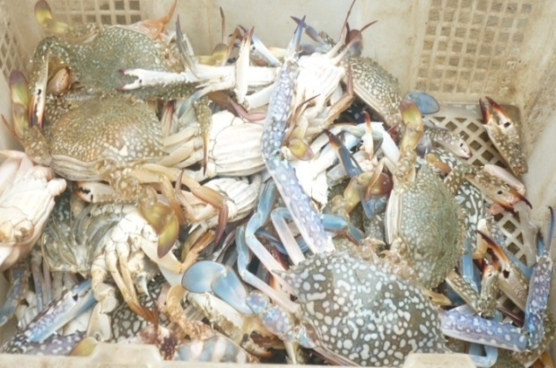
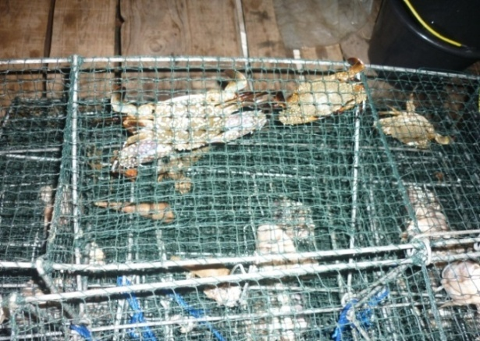
BIOLOGI DAN HARVEST STRATEGY PERIKANAN RAJUNGAN DI LAUT JAWA
Oleh
TRI ERNAWATI
(Peneliti BPPL-P4KSI)
Seminar dan Lokakarya Perikanan Rajungan di Indonesia dan Kajian Peraturan Menteri Kelautan dan Perikanan No.1 dan No. 2.
Kerjasama APRI dan Pusat Penelitian Pengelolaan Perikanan dan Konservasi Sumberdaya Ikan (P4KSI), IPB CONVENTION CENTER Bogor 25 Februari 2015

Slide 2
BACKGROUND
Blue Swimming Crab(BSC) in Java Sea is one of small scale fishery harvest since 1970s.
BSC production in Java sea is about 40 % of national BSC production (2012)
National export of BSC in 2012 is about 28 000 tons and value about US$ 368 milion
Many kinds of gear are used to exploitate BSC in Java Sea.

Slide 3
PROBLEM
High demand of BSC commodities tend to exploited intensively
Population decline was indcated by decline of crab production and sizes of crab especially in Java Sea
Many fishing gears that is not environmental friendly to utilize the BSC
Data on catch effort and biology of BSC is scarce

Slide 4
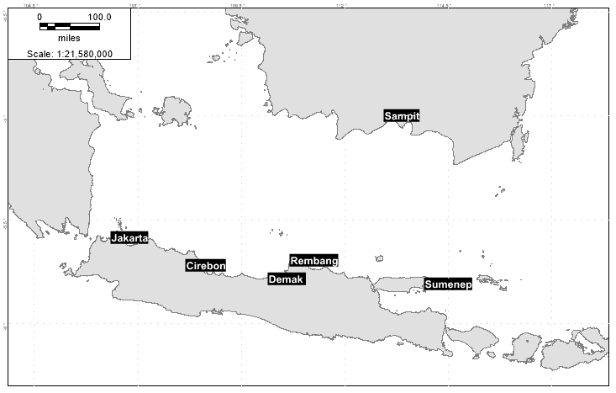
DATA COLLECTION OF BSC
Data Recorded :
From January – December 2014 at 6 sampling sites (Jakarta, Cirebon, Demak, Rembang, Sumenep dan Sampit), 400 samples per month
Biology data : size (carapace width), weight, sex and gonad
Gonad stage female immature, Mature and berried (enumerator)

Slide 5
RESULT

Slide 6
LENGTH-WEIGTH RELATIONSHIP
Sex | Variabel | Length-Weight Relationship (W = aL^{b})
 |  | Jakarta | Cirebon | Demak | Rembang | Sumenep | Sampit
Male | a | 7.00E-05 | 4.00E-05 | 8.00E-06 | 2.00E-05 | 3.10E-03 | 2.00E-05
 | b | 2.9953 | 3.1058 | 3.4489 | 3.2800 | 2.2200 | 3.3100
 | R² | 0.9217 | 0.8653 | 0.9630 | 0.9320 | 0.8303 | 0.8830
Female | a | 1.20E-04 | 6.00E-05 | 1.80E-05 | 1.00E-05 | 3.23E-02 | 5.00E-05
 | b | 2.8803 | 3.0234 | 3.2695 | 3.394 | 1.7118 | 3.0722
 | R² | 0.8714 | 0.8668 | 0.935 | 0.947 | 0.8311 | 0.81
ALL | a | 1.00E-04 | 4.00E-05 | 1.00E-05 | 2.00E-05 | 1.07E-02 | 2.00E-05
 | b | 2.9304 | 3.1019 | 3.3474 | 3.201 | 1.9532 | 3.2211
 | R² | 0.8955 | 0.8678 | 0.9443 | 0.928 | 0.8092 | 0.8512
Male is heavier than female, indicated by b(male)>b(female), except in Rembang

Slide 7
SIZE COMPOSITION
Location | Male |  |  | Female
 | min | max | mean | min | max | mean
Jakarta | 73.4 | 152.0 | 95.3±10.73 | 69.1 | 122 | 94.5±11.43
Cirebon | 71.1 | 151.3 | 111.60±11.64 | 60.0 | 152.6 | 108.08±14.66
Demak | 58.8 | 168.4 | 110.35±18.06 | 40.4 | 166.1 | 112.56±18.21
Rembang | 70.4 | 159.2 | 115.29±15.45 | 75.4 | 165.6 | 116.41±15.81
Sumenep | 75.6 | 148.0 | 115.98±15.62 | 77.2 | 143.8 | 114.87±17.00
Sampit | 87.0 | 165.0 | 134.63±14.73 | 90.0 | 183 | 131.96±14.32

Slide 8
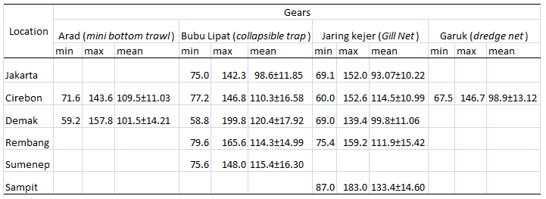
SIZE BY GEARS
SIZE BY GEARS is determined by where the fishing ground are?

Slide 9
GROWTH
Location | Growth parameters
 | L∞ (mm) | k (per year) | to | t max (year)
Cirebon | 168.60 | 1.05 | -0.1040 | 2.86
Demak | 179.35 | 1.11 | -0.1083 | 2.70
Rembang | 178.80 | 1.18 | -0.1155 | 2.54
Sumenep | 161.40 | 1.21 | -0.1219 | 2.48

Slide 10
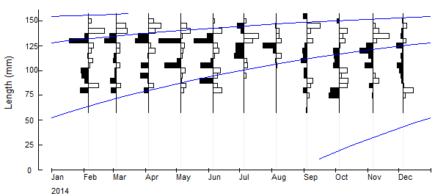
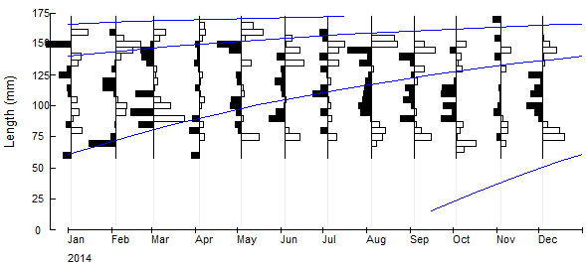
Length (CW) frequency & von Bertalanffy Growth
CIREBON
DEMAK

Slide 11
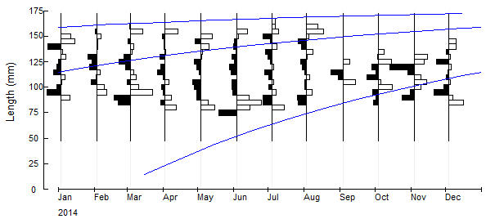
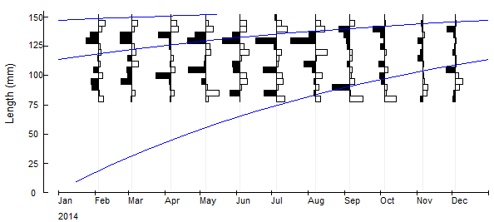
Length (CW) frequency & von Bertalanffy Growth
REMBANG
SUMENEP (MADURA)

Slide 12
LENGTH AT FIRST CAPTURE (Lc)
Location | Mean Length at first capture (Lc/L50)
 | Bubu lipat (Collapsible trap) | Jaring (Gill Net) | Arad (Mini bottom trawl) | Garuk (Dredge Net)
Jakarta | 100.21 | 93.64 | - | -
Cirebon | 109.01 | 107.22 | 108.52 | 99.38
Demak | 123.32 | 101.34 | 105.43 | -
Rembang | 115.72 | 108.84 | - | -
Sumenep | 114.13 | - | - | -
Sampit | - | 130.96 | - | -

Slide 13
LENGTH AT FIRST MATURITY (LM)
Lokasi | Rata-rata ukuran pertama kali matang gonad (Lm/L50)
Location | Mean length at first maturity (Lm/L50)
Jakarta | -
Cirebon | 99.23
Demak | 104.89
Rembang | 101.06
Sumenep | 101.32
Sampit | 123.89
Mean | 106.19 ± 10.11

Slide 14
SPAWNING SEASON

Slide 15
STATUS STOCK BY LENGTH-CONVERTED CATCH CURVE
Lokasi | Parameter mortalitas & Tingkat pemanfaatan
Location | Mortality parameters & Exploitation Rate
 | Z (Total mortality) | M (Natural mortality) | F (Fishing mortality) | E (Exploitation Rate)
Cirebon | 6.24 | 1.15 | 5.09 | 0.82
Demak | 5.41 | 1.17 | 4.24 | 0.78
Rembang | 5.49 | 1.23 | 4.26 | 0.78
Sumenep | 4.65 | 1.26 | 3.36 | 0.72
IT IS INDICATED THAT THE FISHING PRESSURE ON BSC POPULATION IS AT A HEAVILY EXPLOITED LEVEL

Slide 16
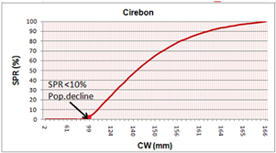
SPAWNING POTENTIAL RATIO (SPR)
Lm = 99 mm CW

Slide 17
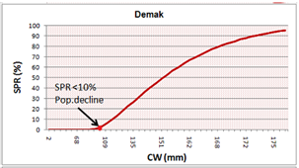
SPAWNING POTENTIAL RATIO (SPR)
Lm = 104.9 mm CW

Slide 18
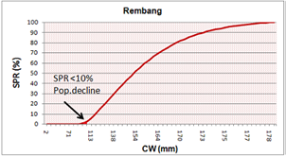
SPAWNING POTENTIAL RATIO (SPR)
Lm = 101 mm CW

Slide 19
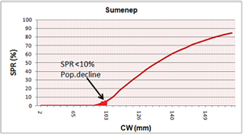
SPAWNING POTENTIAL RATIO (SPR)
Lm = 101,86 mm CW

Slide 20
HARVEST STRATEGY & HARVEST CONTROL RULE
Regulation of BSC fishing zone that not allowed to fishing in nursery ground area (as preservation stock) – Clossed Area Regulation
Apply a minimum legal size of crab (10 cm < )
Clossed season regulation
Use gears enviromental friendly (collabsible trap and gill net)
Not to catch berried/ovegerous female – If caught, return to the sea
Recovery Habitats

Slide 21
THANK YOU

